Slide 1


SQL

Slide 2

TRUNCATE TABLE
TRUNCATE TABLE deletes all the rows in the table.
TRUNCATE TABLE TestData.dbo.Products;
GO

Slide 3
UPDATE TABLE
UPDATE dbo.Products
SET ProductName = 'Flat Head Screwdriver'
WHERE ProductID = 50
GO

Slide 4
RENAME TABLE
EXEC sp_rename 'Employees', 'Attendees’
GO

Slide 5
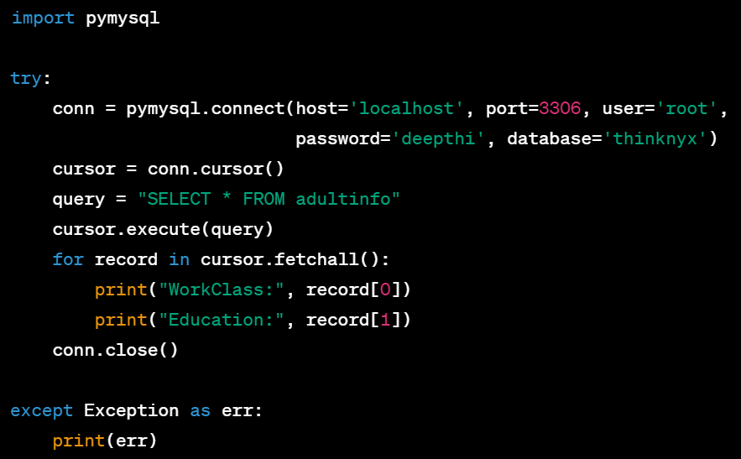
How to use SQL from an application program
Application program
Database Server
Compilation
Compiled Query
Execution
result
Deliver Result

Slide 6
SELECT STATEMENT
Use the SELECT statement to read the data in a table.
The SELECT statement is one of the most important Transact-SQL statements, and there are many variations in the syntax.
SELECT ProductID, ProductName, Price, ProductDescription
FROM dbo.Products
GO
SELECT * FROM dbo.Products
GO

Slide 7
WHERE clause
Use a WHERE clause to limit the rows that are returned to the user.
SELECT ProductID, ProductName, Price, ProductDescription
FROM dbo.Products
WHERE ProductID < 60
GO

Slide 8
ORDER BY clause
The ORDER BY clause is used to sort the result set of a SELECT query based on one or more columns.
SELECT ProductID, ProductName, Price, ProductDescription
FROM dbo.Products
ORDER BY ProductName

Slide 9
Joins & Subqueries

Slide 10

Join
Inserting
Updating
Retrieving
Single Table
Summarizing
Real World

Slide 11


Join
Querying them together becomes essential
Allow us to fetch combined data from multiple tables based on the relationships we’ve designed
JOINS

Slide 12
Example
emp_ID | name | Department_id
1 | Kanishk | T1
2 | Aryan | S1
3 | Dheeraj | -
Department_ID | Department_name
T1 | Tech
S1 | Support
F1 | Finance
One query can get long and harder
Here, aliases become very handy
Short name assigned to a table in a query
Helps in more concise and readable SQL
Employees
Department
We can assign an alias like e to the employees table
Simply use e.emp_Name
Departments can be aliased as d
Join

Slide 13

Inner Join
emp_ID | name | Department_id
1 | Kanishk | T1
2 | Aryan | S1
3 | Dheeraj | -
Department_ID | Department_name
T1 | Tech
S1 | Support
F1 | Finance
Table A
Table B
Returned by Inner Join
SELECT e.name, d.department_name FROM employees e INNER JOIN
departments d
ON e.department_id = d.department_id;
name | Department_name
Kanishk | Tech
Aryan | Support

Slide 14

Outer Join
LEFT OUTER JOIN
Returns:
Records from the left table
Matched records from the right table
If no match, result shows NULLs
SELECT columns FROM left_table LEFT JOIN right_table ON left_table.common_column = right_table.common_column;
Table A​
Table B

Slide 15
Outer Join
LEFT OUTER JOIN
emp_ID | name | Department_id
1 | Kanishk | T1
2 | Aryan | S1
3 | Dheeraj | -
Department_ID | Department_name
T1 | Tech
S1 | Support
F1 | Finance
OUTPUT:
SELECT e.name, d.department_name
FROM employees e
LEFT JOIN departments d
ON e.department_id = d.department_id;
name | Department_name
Kanishk | Tech
Aryan | Support
Dheeraj | NULL
Copyright © Thinknyx Technologies LLP

Slide 16

Outer Join
RIGHT OUTER JOIN
Returns:
Records from the right table
Matched records from the left table
If no match, result shows NULLs
SELECT columns FROM left_table RIGHT JOIN right_table ON left_table.common_column = right_table.common_column;
Copyright © Thinknyx Technologies LLP

Slide 17

Outer Join
RIGHT OUTER JOIN
emp_ID | name | Department_id
1 | Kanishk | T1
2 | Aryan | S1
3 | Dheeraj | -
Department_ID | Department_name
T1 | Tech
S1 | Support
F1 | Finance
SELECT e.name, d.department_name FROM employees e RIGHT JOIN departments d ON e.departmen t_id = d.department_id
name | Department_name
Kanishk | Tech
Aryan | Support
NULL | Finance

Slide 18
Real World Use Case
Inner Join: Used when you want only valid and matched relationships, such as listing employees who are actively assigned to a department, or orders that are linked to valid customers
Left Join: Ideal when the main table is the left one, and you want to retain all its records, like fetching all employees even if they’re waiting for department assignment
Right Join: Handy when the focus is on the right table, like listing all departments — even newly created ones with no assigned staff

Slide 19

Full Outer Join
Its like saying: Give me everything — matched or unmatched — from both tables
Syntax:
SELECT e.employee_name, d.department_name
FROM employees e
FULL JOIN departments d
ON e.department_id = d.department_id;
Returns all employees and departments, Including
Employees without a department
Departments without any employees

Slide 20
Self Join
Its when a table joins with itself
Useful in hierarchical or relational data
employee_name | employee_id | manager_id
Kanishk | 9 | 10
Dheeraj | 4 | 5
Aryan | 12 | 3
SELECT e.employee_name AS employee, m.employee_name AS manager
FROM employees e
JOIN employees m
ON e.manager_id = m.employee_id;
e is an alias for the employee.
m is an alias for the manager.
We join the table on manager_id matching employee_id

Slide 21
Cross Join
Combines every row from one table with every row from another table
Useful when we need to generate all combinations between two entities
Emp_Name
Kanishk
Aryan
Dheeraj
Emp_Dept
Tech
Support
Tech
Emp_Shift
Morning
Evening
Night

Slide 22
Subqueries
Query inside another query
Fetch data that depends on the results of another query
Places where Subqueries are commonly used:
In the WHERE clause
In the SELECT clause
In the FROM clause

Slide 23
Subquery in WHERE Clause
Fetch all employees whose salary is greater than the average salary
First calculate the average salary
Then use that result inside the WHERE clause
SELECT emp_name, salary
FROM employee
WHERE salary > (
SELECT AVG(salary)
FROM employee
);

Slide 24
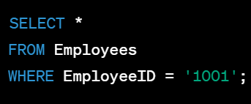

Covert Data
Implicit Conversion
CAST()
CONVERT()
COALESCE()
TRY_CAST()

Slide 25

Tomato Restaurant!
Restaurants
RestaurantID | RestaurantName | Cuisine | Location | Rating
INT PRIMARY KEY | VARCHAR(100) NOT NULL | VARCHAR(50) NOT NULL | VARCHAR(100) NOT NULL | FLOAT
1 | Italian Delights | Italian | New York | 4.5
2 | Spicy Bites | Indian | London | 5
3 | Sushi Palace | Japanese | Tokyo | 4.2

Slide 26
Amazing ecommerce!
ecommerce
CustomerID | FirstName | LastName | Email | Phone | Address | MembershipLevel
INT PRIMARY KEY | VARCHAR(50) NOT NULL | VARCHAR(50) NOT NULL | VARCHAR(100) NOT NULL | VARCHAR(15) | VARCHAR(200) | VARCHAR(200)
1 | John | Doe | john.doe@example.com | +1234567890 | 123 Main St, City | Silver
2 | Jane | Smith | jane.smith@example.com | +0987654321 | 456 Broadway, Town | Gold
3 | Bob | Johnson | bob.johnson@example.com | +9876543210 | 789 Elm St, Village | Bronze

Slide 27
String functions in a SELECT statement
String functions perform an operation on a string input value and return a string or numeric value.
Function | Description | Example | Output
LEN() | Returns the length of a string. | SELECT LEN('Hello, world!') | 13
UPPER() | Converts a string to uppercase. | SELECT UPPER('hello') | HELLO
LOWER() | Converts a string to lowercase. | SELECT LOWER('WORLD') | world
LEFT() | Returns the specified number of characters from the beginning of a string. | SELECT LEFT('Hello, world!', 5) | Hello
RIGHT() | Returns the specified number of characters from the end of a string. | SELECT RIGHT('Hello, world!', 6) | world!
SUBSTRING() | Extracts a substring from a string. | SELECT SUBSTRING('Hello, world!', 7, 5) | world
REPLACE() | Replaces all occurrences of a substring in a string. | SELECT REPLACE('Hello, world!', 'Hello', 'Hi') | Hi, world!
CHARINDEX() | Returns the starting position of a substring in a string. | SELECT CHARINDEX('world', 'Hello, world!') | 7
CONCAT() | Concatenates two or more strings. | SELECT CONCAT('Hello', ', ', 'world', '!') | Hello, world!

Slide 28
String functions in a SELECT statement
String functions perform an operation on a string input value and return a string or numeric value.
SELECT ProductID, UPPER(ProductName)
AS UPPERCASE_ProductName
FROM dbo.Products
SELECT ProductID, CONCAT(ProductName, ' - ',ProductDescription)
AS ProductInfo
FROM dbo.Products
https://learn.microsoft.com/en-us/sql/t-sql/functions/string-functions-transact-sql?view=sql-server-ver16

Slide 29
Date and Time in a SELECT statement
Function | Description | Example | Output
GETDATE() | Returns the current date and time. | SELECT GETDATE() | 2023-07-17 13:45:21.257
DATEPART() | Extracts a specific part (year, month, day, etc.) from a date. | SELECT DATEPART(YEAR, '2023-07-17') | 2023
DATEADD() | Adds or subtracts a specified interval to a date. | SELECT DATEADD(DAY, 7, '2023-07-17') | 2023-07-24
DATEDIFF() | Calculates the difference between two dates. | SELECT DATEDIFF(DAY, '2023-07-10', '2023-07-17') | 7
FORMAT() | Formats a date value. | SELECT FORMAT(GETDATE(), 'yyyy-MM-dd HH:mm:ss') | 2023-07-17 13:45:21
DAY() | Returns the day of the month from a date. | SELECT DAY('2023-07-17') | 17
MONTH() | Returns the month from a date. | SELECT MONTH('2023-07-17') | 7
YEAR() | Returns the year from a date. | SELECT YEAR('2023-07-17') | 2023

Slide 30
Date and Time in a SELECT statement
SELECT GETDATE() AS CurrentDateTime
SELECT DAY('2015-04-30 01:01:01.1234567')
SELECT SYSDATETIME();
IF ISDATE('2009-05-12 10:19:41.177') = 1
SELECT 'VALID';
ELSE
SELECT 'INVALID';
SELECT COUNT(*) FROM citizens WHERE TIMESTAMPDIFF(YEAR,dob,CURDATE()) >=18;
https://learn.microsoft.com/en-us/sql/t-sql/functions/date-and-time-data-types-and-functions-transact-sql?view=sql-server-ver16

Slide 31
Mathematical functions in a SELECT statement
Function | Description | Example | Output
ABS() | Returns the absolute value of a number. | SELECT ABS(-5) | 5
CEILING() | Rounds a number up to the nearest integer. | SELECT CEILING(4.3) | 5
FLOOR() | Rounds a number down to the nearest integer. | SELECT FLOOR(4.7) | 4
ROUND() | Rounds a number to a specified decimal place. | SELECT ROUND(4.567, 2) | 4.57
EXP() | Returns the exponential value of a number. | SELECT EXP(2) | 7.389
POWER() | Raises a number to a specified power. | SELECT POWER(2, 3) | 8
SQRT() | Returns the square root of a number. | SELECT SQRT(16) | 4
RAND() | Returns a random value between 0 and 1. | SELECT RAND() | 0.123
SIGN() | Returns the sign of a number (-1, 0, or 1). | SELECT SIGN(-3) | -1
AVG() | Returns the average value of a column. | SELECT AVG(Rating) FROM Restaurants | Average Rating
MAX() | Returns the maximum value of a column. | SELECT MAX(Rating) FROM Restaurants | Maximum Rating
ROUND() | Rounds a number to a specified decimal place. | SELECT ROUND(4.567, 2) FROM Restaurants | 4.57

Slide 32
Mathematical functions in a SELECT statement
SELECT AVG(Price) AS AveragePrice
FROM Products;
SELECT MAX(Price) AS MaxPrice, MIN(Price) AS MinPrice
FROM Products;
SELECT ProductID, ProductName, Price,
ROUND(Price, 0) AS RoundedPrice
FROM Products;
https://learn.microsoft.com/en-us/sql/t-sql/functions/mathematical-functions-transact-sql?view=sql-server-ver16

Slide 33
Other functions
Statement | Explanation | Result
SELECT CAST(55.65 AS INT); | Casting 55.65 to an integer using CAST function. | 55
SELECT IIF(5 < 10, 'YES', 'NO'); | Using IIF function to check if 5 is less than 10. | 'YES'
SELECT ISNULL(NULL, ‘www. thinknyx.com'); | Checking if the first parameter is NULL, return the second parameter. | www.thinknyx.com'
SELECT ISNUMERIC(‘1234'); | Checking if 1234' is a numeric value using ISNUMERIC function. | 1 (True)
SELECT NULLIF(5, 5); | Returning NULL if both parameters are equal using NULLIF function. | NULL
SELECT SYSTEM_USER; | Retrieving the current system user using SYSTEM_USER function. | 'Your System User'
SELECT CURRENT_USER; | Retrieving the current user connected to the database using CURRENT_USER function. | 'Your Current User'

Slide 34
How to work with other database objects
Working with other database objects in SQL involves creating, modifying, and deleting various objects like:
Views
Stored procedures
Functions and
Triggers.

Slide 35
How to work with other database objects
Views
Views are virtual tables that display data from one or more underlying tables.
They allow you to simplify complex queries and provide a customized view of the data to users.
-- Creating a view to display high-rated Italian restaurants
CREATE VIEW HighRatedItalianRestaurants AS
SELECT RestaurantName, Location, Rating
FROM Restaurants
WHERE Cuisine = 'Italian' AND Rating >= 4.5;
-- Get the view
SELECT * FROM HighRatedItalianRestaurants

Slide 36
How to work with other database objects
Stored Procedures
Stored procedures are pre-compiled SQL statements that can be executed with a single call.
They help encapsulate complex logic and improve code reusability.
-- Creating a stored procedure to get the total number of restaurants by cuisine
CREATE PROCEDURE GetRestaurantCountByCuisine
@Cuisine VARCHAR(50)
AS
BEGIN
SELECT COUNT(*) AS TotalCount
FROM Restaurants
WHERE Cuisine = @Cuisine;
END;
--Display the result
EXEC GetRestaurantCountByCuisine @cuisine='Italian'

Slide 37
How to work with other database objects
Functions
Functions are routines that return a single value based on the input arguments.
They can be used in SQL queries just like any other expression.
-- Creating a function to calculate the average rating of Italian restaurants
CREATE FUNCTION GetAverageRatingByCuisine
(@Cuisine VARCHAR(50))
RETURNS FLOAT
AS
BEGIN
DECLARE @AvgRating FLOAT;
SELECT @AvgRating = AVG(Rating)
FROM NewRestaurants
WHERE Cuisine = @Cuisine;
RETURN @AvgRating;
END;
-- Call the function to get the average rating for Italian restaurants in New York
DECLARE @AvgRating FLOAT;
SET @AvgRating = dbo.GetAverageRatingByCuisine('Italian');
SELECT @AvgRating AS AverageRating;

Slide 38
How to work with other database objects
Triggers
Triggers are special stored procedures that are automatically executed in response to specific events, such as data modification.
CREATE TRIGGER UpdateRestaurantCount
ON NewRestaurants
AFTER INSERT
AS
BEGIN
PRINT 'Trigger Executed';
DECLARE @RestaurantCount INT;
SELECT @RestaurantCount = COUNT(*) FROM NewRestaurants;
PRINT @RestaurantCount;
-- INSERT the new RestaurantCount into SumTable
INSERT INTO SumTable (RestaurantCount)
VALUES (@RestaurantCount);
END;

Slide 39
Aggregate and Inbuilt Functions
Aggregate Function | Description
COUNT() | Counts the total number of records specified by the given condition.
SUM() | Returns the sum of all the non-NULL values in the specified column.
AVG() | Returns the average of all the non-NULL values in the specified column.
MIN() | Returns the minimum value in the specified column (NULL values are not included in the calculation).
MAX() | Returns the maximum value in the specified column (NULL values are not included in the calculation).

Slide 40
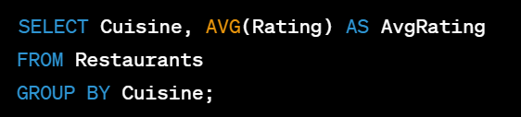
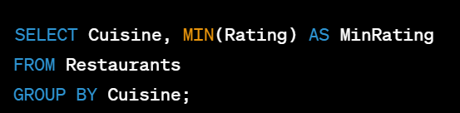
Aggregate and Inbuilt Functions
GROUP BY
Cuisine | AvgRating
Italian | 4.35
Indian | 3.8
Japanese | 4.0
American | 4.3
Thai | 3.9
Cuisine | MinRating
Italian | 4.2
Indian | 3.8
Japanese | 4.0
American | 4.3
Thai | 3.9

Slide 41
Aggregate with ‘having’ clause
The HAVING clause is used to further filter the results of aggregate functions in SQL queries.
It allows you to apply conditions to the groups formed by the GROUP BY clause after the aggregation is performed.
This enables you to restrict the output of aggregate functions based on specific conditions.

Slide 42
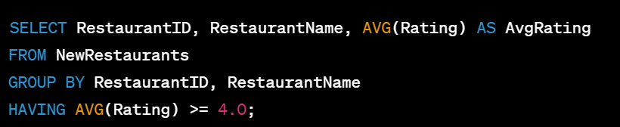
Aggregate with ‘having’ clause

Slide 43
Summarize data using SQL Server extensions
Method | Explanation
ROLLUP | Generates subtotal and grand total rows for selected columns. Produces multiple levels of aggregation, providing a hierarchical view of the data.
CUBE | Generates all possible combinations of selected columns to provide a multidimensional summary. Similar to ROLLUP, but generates more combinations for a comprehensive view.
GROUPING SETS | Allows specifying multiple grouping sets in a single query. Enables obtaining various summaries at different levels, aggregating data according to the specified sets.
PARTITION BY | Used with window functions to create separate groups of rows for each distinct value in the specified column. Enables performing aggregate functions within these groups.
PIVOT | Rotates rows into columns, creating a summary table in a cross-tabulated format. Useful for transforming data for easier analysis and reporting.
UNPIVOT | The reverse of PIVOT. Transforms columns into rows, which is useful for normalizing data and summarizing it in a more structured way.

Slide 44
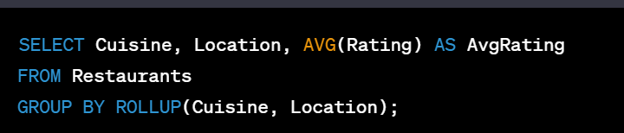
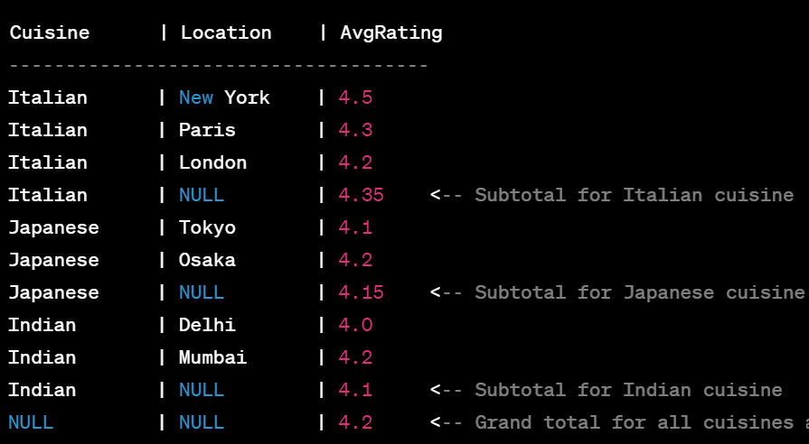
Summarize data using SQL Server extensions
Rollup

Slide 45
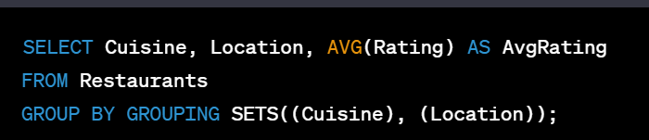
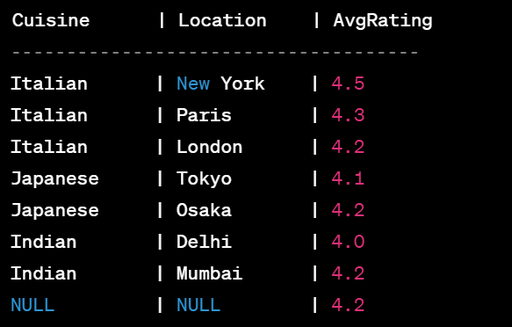
Summarize data using SQL Server extensions
Grouping Sets

Slide 46
Joins
Joins in SQL are used to combine rows from two or more tables based on a related column between them, allowing data from multiple tables to be retrieved and presented together in a single result set.
It is used with the SELECT statement.

Slide 47
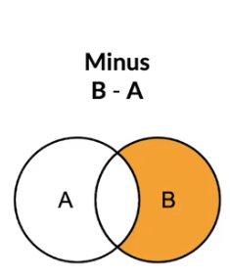
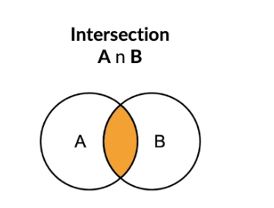
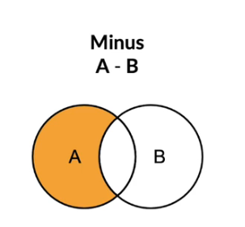
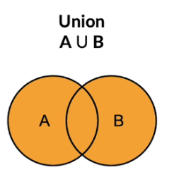
Venn Diagram

Slide 48
Joins
Join Type | Description
INNER JOIN | Returns only the rows that have matching values in both tables, excluding non-matching rows.
LEFT (OUTER) JOIN | Returns all rows from the left table and matching rows from the right table, filling non-matching rows with NULL.
RIGHT (OUTER) JOIN | Returns all rows from the right table and matching rows from the left table, filling non-matching rows with NULL.
(FULL) OUTER JOIN | Returns all rows when there is a match in either the left or right table, filling non-matching rows with NULL.

Slide 49
Joins
Orders
Customers
OrderID | CustomerID | OrderDate
INT PRIMARY KEY | INT | DATE
101 | 1 | 2023-07-15
102 | 2 | 2023-07-16
103 | 1 | 2023-07-17
104 | 3 | 2023-07-18
105 | 2 | 2023-07-18
CustomerID | CustomerName | Country
INT PRIMARY KEY | VARCHAR(50) NOT NULL | VARCHAR(50) NOT NULL
1 | John Smith | USA
2 | Jane Doe | Canada
3 | Michael Johnson | UK

Slide 50
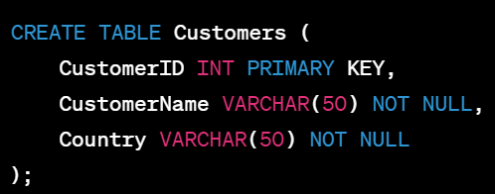
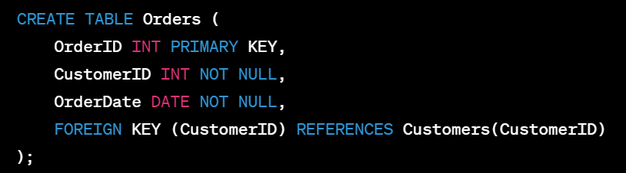
Joins

Slide 51
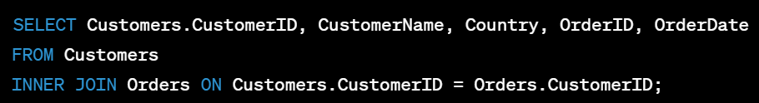
Inner Join
CustomerID | CustomerName | Country | OrderID | OrderDate
1 | John Smith | USA | 101 | 2023-07-15
2 | Jane Doe | Canada | 102 | 2023-07-16
1 | John Smith | USA | 103 | 2023-07-17
3 | Michael Johnson | UK | 104 | 2023-07-18
2 | Jane Doe | Canada | 105 | 2023-07-18

Slide 52
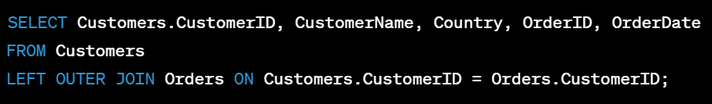
Left Outer Join
CustomerID | CustomerName | Country | OrderID | OrderDate
1 | John Smith | USA | 101 | 2023-07-15
1 | John Smith | USA | 103 | 2023-07-17
2 | Jane Doe | Canada | 102 | 2023-07-16
2 | Jane Doe | Canada | 105 | 2023-07-18
3 | Michael Johnson | UK | 104 | 2023-07-18
4 | Deepthi Narayan | India | NULL | NULL

Slide 53
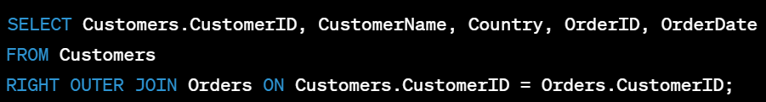
Right Outer Join
CustomerID | CustomerName | Country | OrderID | OrderDate
1 | John Smith | USA | 101 | 2023-07-15
2 | Jane Doe | Canada | 102 | 2023-07-16
1 | John Smith | USA | 103 | 2023-07-17
3 | Michael Johnson | UK | 104 | 2023-07-18
2 | Jane Doe | Canada | 105 | 2023-07-18
NULL | NULL | NULL | 106 | NULL

Slide 54
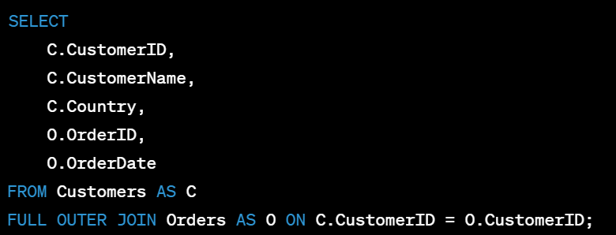
Full Outer Join
CustomerID | CustomerName | Country | OrderID | OrderDate
1 | John Smith | USA | 101 | 2023-07-15
1 | John Smith | USA | 103 | 2023-07-17
2 | Jane Doe | Canada | 102 | 2023-07-16
2 | Jane Doe | Canada | 105 | 2023-07-18
3 | Michael Johnson | UK | 104 | 2023-07-18
4 | Deepthi Narayan | India | NULL | NULL
NULL | NULL | NULL | 106 | NULL

Slide 55
Union
The UNION query combines all rows from both tables and provides NULL values for columns that do not exist in the respective tables.
Aspect | Joins | UNION
Purpose | Retrieve data from related tables based on matching columns. | Combine rows from multiple SELECT statements into a single result set.
Syntax | Uses JOIN clause with ON condition to specify the relationship between tables. | Uses UNION keyword to combine SELECT statements. Columns must have the same data types and number of columns.
Data Sources | Combines rows from two or more tables. | Combines rows from the same or similar tables.
Result Set | Returns columns from multiple tables in the joined result set. | Returns columns from each SELECT statement stacked on top of each other in a single result set.

Slide 56
Union
CustomerID | CustomerName | Country | OrderID | OrderDate
1 | John Smith | USA | NULL | NULL
2 | Jane Doe | Canada | NULL | NULL
3 | Michael Johnson | UK | NULL | NULL
4 | Deepthi Narayan | India | NULL | NULL
NULL | NULL | NULL | 101 | 2023-07-15
NULL | NULL | NULL | 102 | 2023-07-16
NULL | NULL | NULL | 103 | 2023-07-17
NULL | NULL | NULL | 104 | 2023-07-18
NULL | NULL | NULL | 105 | 2023-07-18
NULL | NULL | NULL | 106 | NULL
SELECT CustomerID, CustomerName, Country, NULL AS OrderID, NULL AS OrderDate
FROM Customers
UNION
SELECT NULL AS CustomerID, NULL AS CustomerName, NULL AS Country, OrderID, OrderDate
FROM Orders;

Slide 57
Views
Views are virtual tables that display data from one or more underlying tables.
They allow you to simplify complex queries and provide a customized view of the data to users.

Slide 58
Views
Advantages of Views:
Simplify Complex Queries | Code Reusability
Data Security | Reporting and Analysis
Data Abstraction | Simplicity and Maintainability
Data Integrity | Abstraction of Complex Logic
Performance Optimization

Slide 59
Views
Create and Use Views:
-- Creating a view to display high-rated Italian restaurants
CREATE VIEW HighRatedItalianRestaurants AS
SELECT RestaurantName, Location, Rating
FROM Restaurants
WHERE Cuisine = 'Italian' AND Rating >= 4.5;
-- Get the view
SELECT * FROM HighRatedItalianRestaurants
RestaurantName | Location | Rating
Pizza Hut | Bangalore | 5
Italian Delights | New York | 5
Dominos | Delhi | 5

Slide 60
Views
Alter and Delete the Views:
-- Modifying the view to show only top 5 restaurants
ALTER VIEW HighRatedItalianRestaurants AS
SELECT TOP 5 RestaurantName, Location, Rating
FROM Restaurants
WHERE Cuisine = 'Italian' AND Rating >= 4.5;
-- Deleting the view
DROP VIEW HighRatedItalianRestaurants;

Slide 61
View Designer
The View Designer is a graphical tool in SQL Server Management Studio (SSMS) that allows you to create and modify views using a visual interface.
Right-click on the "Views" folder, then select "Add New View."
The View Designer window will open, displaying a diagram pane and the "Add Table" dialog box.
In the "Add Table" dialog box, select the tables or views that you want to include in your view. You can drag and drop tables from the dialog box into the diagram pane.
After adding the tables to the diagram pane, you can define the columns you want to include in your view by checking the appropriate columns in each table.
Once you've defined your view, click the "OK" button to close the View Designer window.
In the "Save" dialog box, enter a name for your view and click "OK" to create the view in the database.

Slide 62
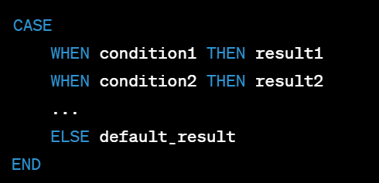
Case Statement
A CASE statement in SQL is used to conditionally return a value based on one or more conditions. It's similar to the "if-else" construct in programming languages.

Slide 63
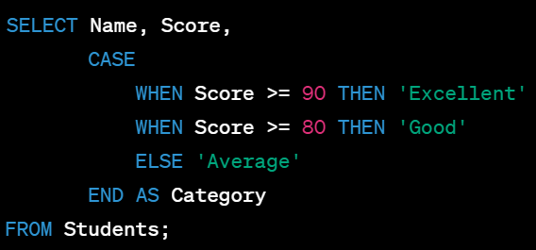
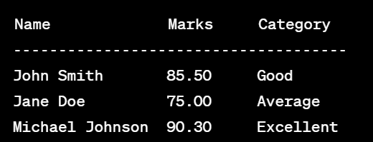
Case Statement

Slide 64
Case Statement
SELECT CustomerName,
CASE
WHEN Country = 'USA' THEN 'Domestic'
ELSE 'International'
END AS CustomerType
FROM Customers;

Slide 65
Case Statement
SELECT CustomerName,
CASE
WHEN Country = 'USA' THEN 'Domestic'
ELSE 'International'
END AS CustomerType
FROM Customers;

Slide 66
COALESCE Statement
SELECT Customers.CustomerName, COALESCE(Orders.OrderID, 0) AS OrderID
FROM Customers
LEFT JOIN Orders ON Customers.CustomerID = Orders.CustomerID;

Slide 67
Self join
CustomerID | CustomerName | Country
1 | John Smith | USA
2 | Jane Doe | Canada
3 | Michael Johnson | UK
4 | Alice Brown | USA
5 | Bob White | Canada
SELECT C1.CustomerName AS Customer1, C2.CustomerName AS Customer2, C1.Country FROM Customers
C1 JOIN Customers C2 ON C1.Country = C2.Country AND C1.CustomerID <> C2.CustomerID;

Slide 68
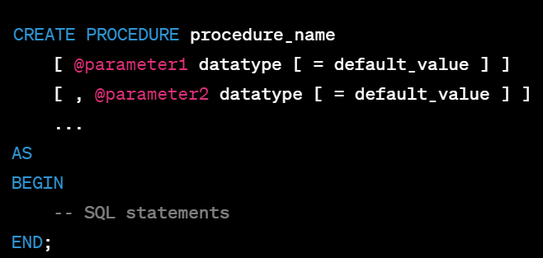
Procedures
In SQL, a stored procedure is a group of SQL statements that are stored in the database and can be executed as a single unit.
It allows you to encapsulate and reuse a set of SQL statements, making it easier to manage and maintain complex operations.
Stored procedures can accept input parameters, perform operations on the database, and return results.

Slide 69

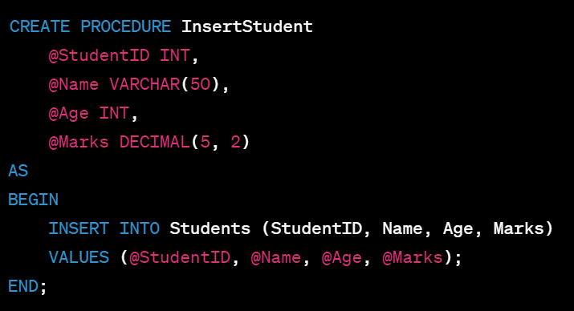
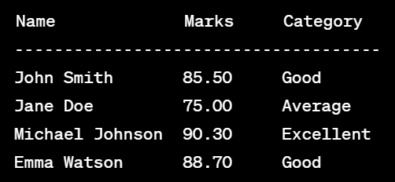
Procedures

Slide 70
Subqueries
Subqueries, also known as nested queries or inner queries, are queries within queries.
They are used to retrieve data from one or more tables and use that result to filter or further process data in another query.
Subqueries are enclosed within parentheses and can be used in SELECT, INSERT, UPDATE, and DELETE statements.

Slide 71
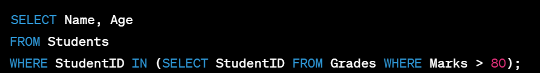
Subqueries
STUDENTS
GRADES
StudentID | Name | Age
1 | John | 20
2 | Jane | 19
3 | Michael | 21
StudentID | Marks
1 | 85.50
2 | 75.00
3 | 90.30

Slide 72
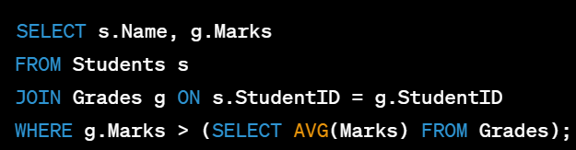
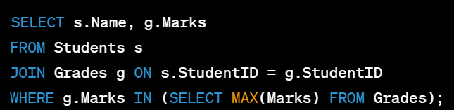
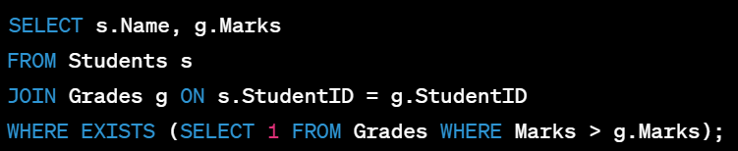
Subqueries in search conditions
Subquery in WHERE Clause with Comparison Operators
Subquery with IN Operator
Subquery with EXISTS Operator

Slide 73
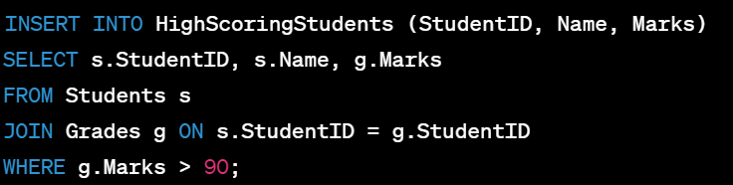
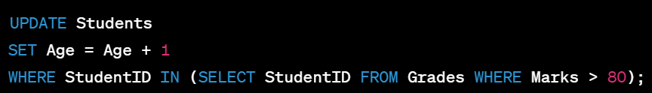

Other ways to use Subqueries
In INSERT Statement
In UPDATE Statement
In DELETE Statement

Slide 74
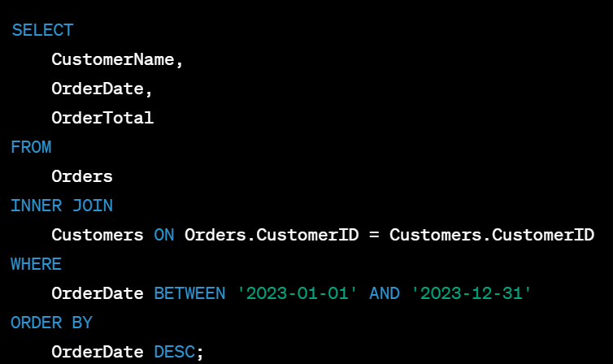
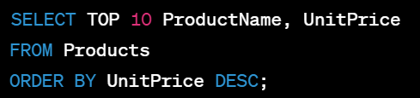
Guidelines for working with complex queries
Plan and Break Down the Query
Use Proper Indentation and Formatting
Suppose you have a database of online orders, and you want to find the total revenue for each month. Break down the query into steps like extracting month-wise sales, calculating revenue, and finally grouping by month.
Optimize Performance

Slide 75
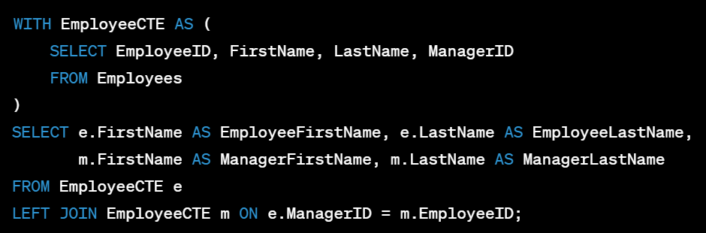
Guidelines for working with complex queries
Test and Validate
Use Proper Indentation and Formatting
Before executing a complex query in a production environment, test it on a smaller dataset or in a test environment. Validate the query output to ensure it returns the expected results.
Use Subqueries and Common Table Expressions (CTEs)

Slide 76
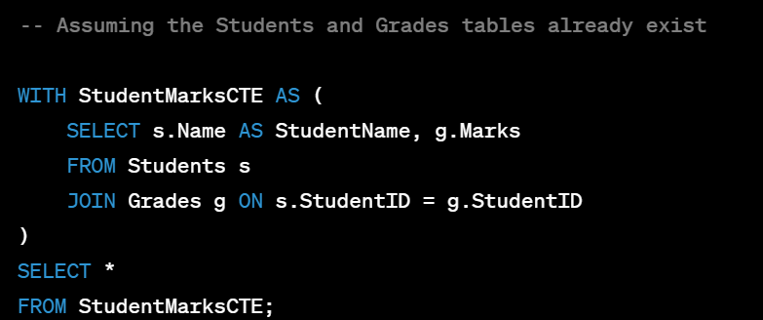
Common Table Expressions
Common Table Expressions (CTEs) are temporary result sets that can be used within a SELECT, INSERT, UPDATE, or DELETE statement in SQL.
They are similar to derived tables or subqueries but provide a more structured and readable way to break down complex queries into smaller logical components.

Slide 77
Sequence
In SQL, a sequence is an object that generates a sequence of numeric values based on a defined pattern.
Sequences are often used to generate unique and sequential values for columns in a table.

Slide 78
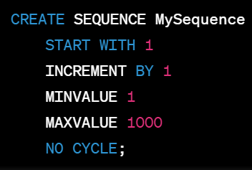
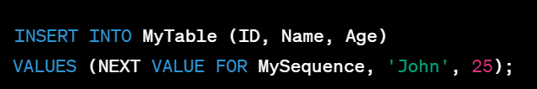

Sequence
Creating a Sequence
Using a Sequence in INSERT Statements
Getting the Current Value of a Sequence
Advancing the Sequence
SELECT current_value FROM sys.sequences WHERE name = 'MySequence' ;

Slide 79
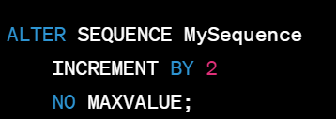

Sequence
Altering a Sequence
Dropping a Sequence

Slide 80
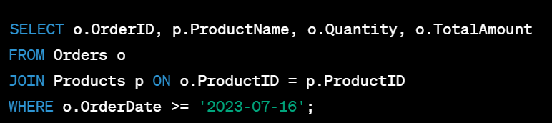
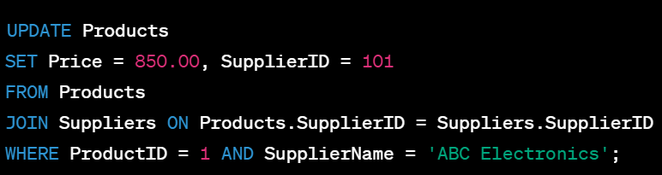
Chaining various statements and clauses withing a single query
SELECT Statement with JOIN and WHERE Clause
UPDATE Statement with JOIN and WHERE Clause

Slide 81
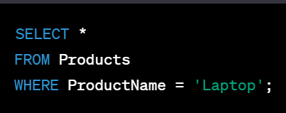
Index
If the ProductName column is indexed, the database optimizer will recognize that there is an index on this column and will use it to quickly find all rows with the specified product name. This will result in faster data retrieval compared to searching the entire table without an index.

Slide 82

Index
Indexes are used to speed up data retrieval by providing a quick lookup mechanism for specific columns in a table.
They can significantly improve the performance of queries that involve these columns.

Slide 83
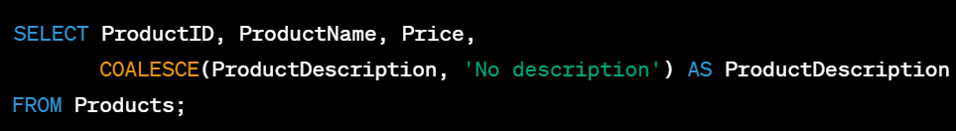
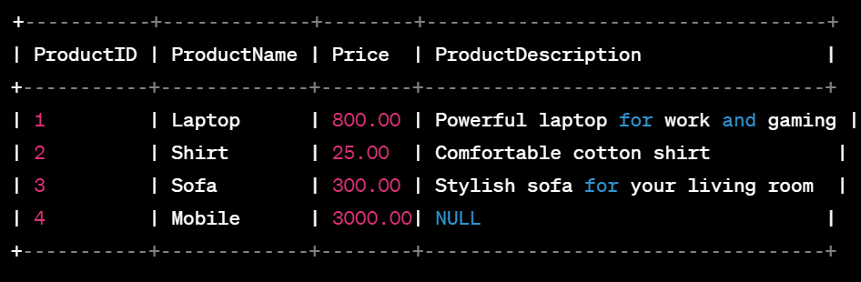
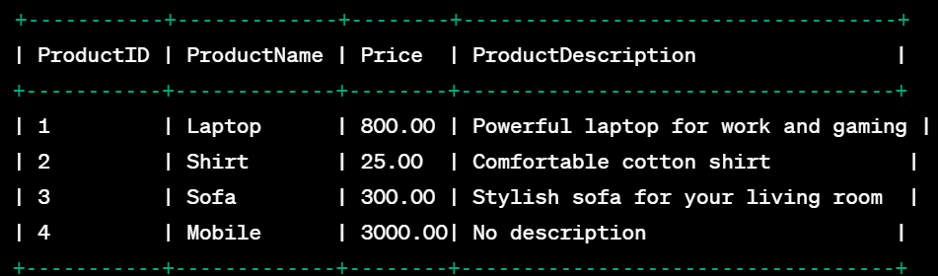
Combine Rows
COALESCE
COALESCE is a SQL function used to return the first non-null value from a list of expressions or columns. It allows you to provide a default value when the original value is null, ensuring that a valid result is always returned.

Slide 84
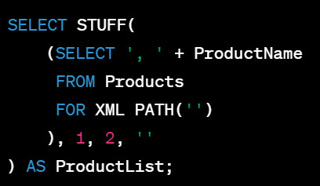

Combine Rows
XML Path
XML PATH is a feature in SQL Server that allows you to concatenate values from multiple rows into a single XML string in a result set.

Slide 85

Working with database keys to restrict and protect data
Access Control
Encryption
Auditing and Monitoring
Secure Configuration
Data Masking and Anonymization
Backup and Recovery

Slide 86
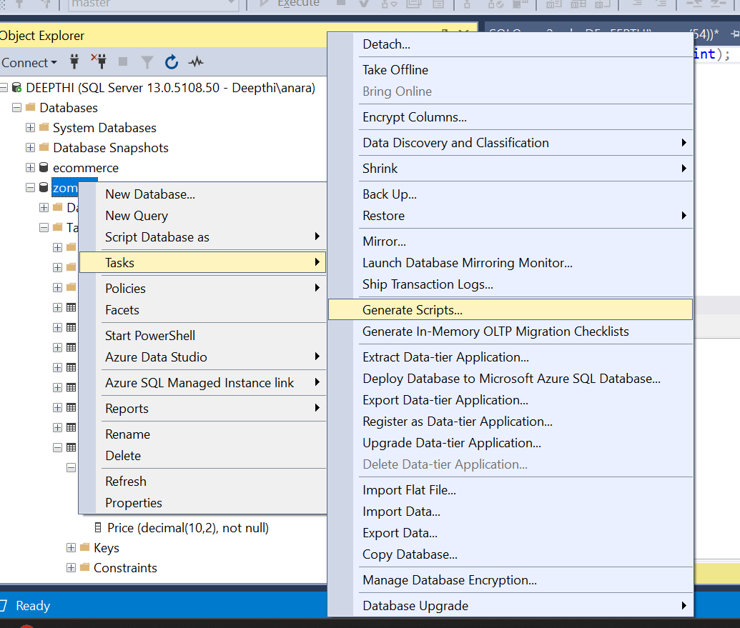
Creating a Database and Its Tables with Management Studio
https://learn.microsoft.com/en-us/troubleshoot/sql/database-engine/performance/stats-only-db-script

